Slide 1
Chapter 8
— 例题与作业

Slide 2
Examples
Paging中逻辑地址-物理地址-页表结构及地址变换
例1. Fig. 8.9
例2，例3，例4, 例5
例6. EAT in TLB-based paging
Paging with segmentation
例7，例8，例9
多级页表结构
例10 Fig. 8.12, 例11
例12. 内存扩展-CPU利用率-吞吐量
补充作业
作业：
8.3, 8.9, 8.12
补充作业

Slide 3
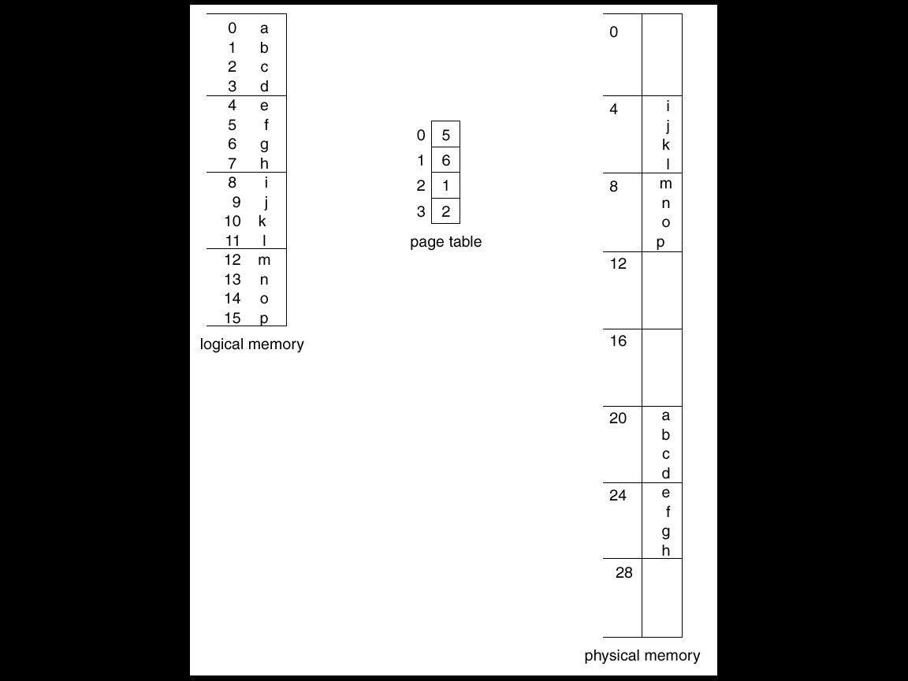
例1. 逻辑地址-物理地址变换
P# :
0
f# :
0
1
2
3
4
5
6
7
f#:
page size 4 bytes
Logical space
4 pages =16 bytes=2⁴ B
logical address consists of m=4 bits, i.e. **, **
Physical memory
8 frames =32 bytes=2⁵B
physical address consists of 5 bits, i.e. ***, **
1
2
3
e.g. m=4, n=2
Fig.8.9

Slide 4
例1.
Address mapping in Fig. 8.9
e.g.1 logical address 0, i.e. 00,00
page number=00, page offset=00
page table: page 0 is allocated to frame 5, that is, 101
physical address : 10100, or: 5 * 4 + 0 =20
e.g.2 logical address 9, i.e. 10,01
page number=2, i.e, 10, page offset=1, i.e. 01
page table: page 2 is allocated to frame 1, that is, 001
physical address : 1* 4 + 1 =5, or: 00101

Slide 5
例2
On a system using fixed partitions with sizes 2⁸, 2²⁴ and 2⁶⁴ bytes, how many bits must the limit register have?
Answer
64 bits in the limit register

Slide 6
例3
On a simple (not virtual memory ) paging system with 2²⁴ bytes of physical memory, 256 pages of the logical address space, and a page size of 2¹⁰ bytes, how many bits are in a logical address?
Answer
the logical address space contains 256 (＝2⁸) pages of 2¹⁰ bytes each, making the total logical address space 2¹⁰ × 2⁸ = 2¹⁸ bytes
an 18-bit address is required to cover a 2¹⁸-byte address space
note: the size of the logical address space is less than that of physical memory

Slide 7
例4
On a simple paging system with a page table containing 512 entries of 16 bits (including one valid/invalid bit) each, and a page size of 1024 (i.e.2¹⁰ ) bytes
(a) what is the size of the logical address space?
2¹⁹ = the number of pages * the size of pages
= 512*1024 (bytes)
(b) how many bits are there in a logical address?
19 = log₂(the size of logical address space)
= log₂(512 * the size of pages)=log₂(512*2¹⁰) (bits)
(c) how many bits in the physical address specify the frame number?
15= the length of entries in the page table -1
=16 -1 (bits)

Slide 8
Logical Address Space
page number
page/frame offset
18
10
9
0
v
15 high bits of physical address
frame#
concatenate
512
=2⁹
entries
….
Page
Table
15
14
0
15 high bits
10 low bits
Physical Address Space

Slide 9
例4
(d) how many bits in the physical address specify the offset within the frame?
10 = log₂(the size of a frame) = log₂(1024) (bits)
(e ) what is the size of the physical address space ？
2²⁵ bytes = the number of frames * the size of frames
= 2⁽¹⁶⁻¹⁾ *2¹⁰ bytes
(f) how many bits are there in a physical address?
25 = log₂(the size of physical memory)
= log₂ (2²⁵ bytes ) bits

Slide 10
例5
On a simple paging system with 2³² bytes of physical memory, 2¹² pages of the logical address space, and page size of 512=2⁹ bytes
(a) how many bits are in a logical address?
21 = log₂(the size of logical address space)
= log₂(2¹² pages * page size ) = log₂(2¹² * 2⁹)
(b) how many bytes are there in a frame?
512 bytes, the same as that in a page
(c) how many bits in the physical address specify the frame number?
23 = log₂(physical memory size2³²) – log₂(page size)
= log₂(2³²) - log₂(2⁹)

Slide 11
例5
(d) how many entries are in the page table (how long is the page table) ?
2¹², the number of pages in the logical address space
(e) how many bits in the logical address specify the page number?
12 = log₂(the number of pages) =log₂(2¹²)
(f) how many bits in the logical address specify the offset within a page?
9 = log₂(the size of pages) =log₂(2⁹)

Slide 12
例6. EAT in TLB-based paging
Hit ratio α – percentage of times that a page number is found in the TLB
E.g. It is supposed
the hit ratio is 80%
it takes 20 ns to search the TLB and 100ns to access memory, then
a mapped-memory access takes 120 ns when the page number is in TLB, because it takes 20ns to search TLB and 100 ns to access memory
if the page number is not in TLB (20 ns), the we must first access the memory for the page table and frame number (100ns), then access the desired the page in memory (100ns), for a total 220 ns
by weighting each case by its probability, we obtain the EAT as
EAT = 0.80 ╳ (20+100) + 0.20 ╳ (20+ 100 + 100)
= 140 ns

Slide 13
例7
On a system of segmentation with paging, the logical address space consists of up to 16 segments where each segment can be up to 2¹⁶ bytes long. The hardware pages each segment into 512-byte pages
how many bits in the logical address specify the following ?
(a) segment number
4 = log₂ (the number of segments)= log₂(16)
(b) page number
7 = log₂(the number of pages)
= log₂(the size of segments /
the size of pages )
= log₂( 2¹⁶ /2⁹)
segment
number
offset in segment
page
number
offset
in page

Slide 14
例7
(c) offset within pages
9 = log₂(the size of pages) = log₂ 512
(d) entire logical address
20 = the bits for segment number
+ the bits for page number
+ the bits for offset within pages
or: 20 = log₂(the size of the logical address space)
= log₂(the number of segments * the size of segments)
= log₂(16 * 2¹⁶ )
segment
number
offset in segment
page
number
offset
in page

Slide 15
例8
Consider a system using segmentation with paging management scheme, whose physical memory is of 2³⁵ bytes. The logical address space consists of up to 8 segments. Each segment can be up to 2¹³ pages, and the page size of 512 bytes,
(1) How many bits are there in the entire logical address?
the entire logical address consists of segmentation and offset in segmentation, and offset in segmentation is divided into page number and page offset, so entire logical address has
log2 (8) + log2(2¹³) + log2 (512) = 3 + 13 +9 =25 bits

Slide 16
例8
(2) How many bits in the logical address specify the page number?
each segment consists of up to 2¹³ pages, so log₂(2¹³) = 13 bits in the logical address specify the page number
(3) What is the size of a frame?
the size of a frame is equal to that of a page, i.e. 512 bytes
(4) How many bits in the physical address specify the frame number?
the total size of physical memory is 2³⁵ bytes, and each frame is 2⁹ = 512 bytes, so there are 26 = (35 – 9) bits in the physical address specify the frame number

Slide 17
例8
(5) How many bits in the physical address specify the frame offset?
the number of bits in the physical address specifying the frame offset depends on the size of the frame, so
log₂ (2⁹) = 9 bits
in the physical address specify the frame offset
(6) How many entries are there in the page table for each segmentation, i.e. how long is the page table for each segmentation?
each entry in the page table corresponds to a page in the segment, each segment can be up to 2¹³ pages, so there are 2¹³ entries in the page table for each segment

Slide 18
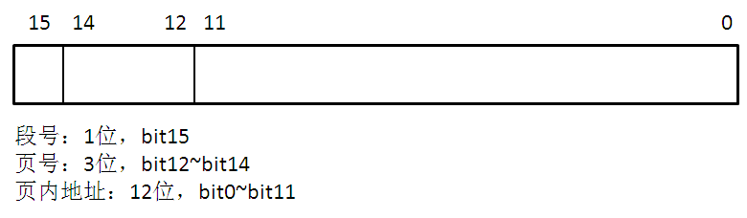
例9
A system using segmentation with paging has a 16-bit logical address space with 2 segments per process and a page size of 2¹² bytes
(1) Draw a figure to indicate the components of a logical address, and specify how many bits are there in each component

Slide 19
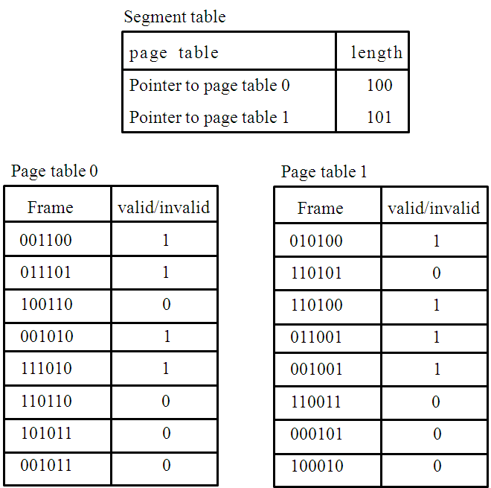
例9
(2) If the content of the segment and page tables is specified below (all values binary).
For the following binary logical addresses, indicate what physical address they would be translated into, or if they would a page fault.
(a) 0, 001, 010001010111
(b) 0,100, 010011111111
(c) 1, 011, 010011000111
(d) 1, 110, 001011000111

Slide 20
(2) answers
4页
5页
#Page
000
001
010
011
100
101
110
111
P#
000
001
010
011
100
101
110
111
(a) 0 001 010001010111 ==> 011101, 010001010111
(b) 0 100 010011111111 ==> 111010, 0100 1111 1111
(c) 1 011 010011000111 ==> 011001, 010011000111
(d) 1 110 001011000111 ==> page fault

Slide 21
例10 Fig. 8.12
A logical address (on 32-bit machine with 4K page size) is divided into:
a page number consisting of 20 bits
a page offset consisting of 12 bits
The page table itself is also paged, the page number is further divided into
a 10-bit page number,
a 10-bit page offset.
注：高位一分为二，各10bits，
内外页表采用相同大小的chunk
page number
outer page
inner page
page offset
p_{i}
p₂
d
10
10
12
the number of entries in the table: 2²⁰=1M=2¹⁰*2¹⁰=1K*1K
1M=2²⁰ entries in the page table is divided into 2¹⁰ chunks, and each chunk contains 2¹⁰ entries and located in a contiguous space

Slide 22
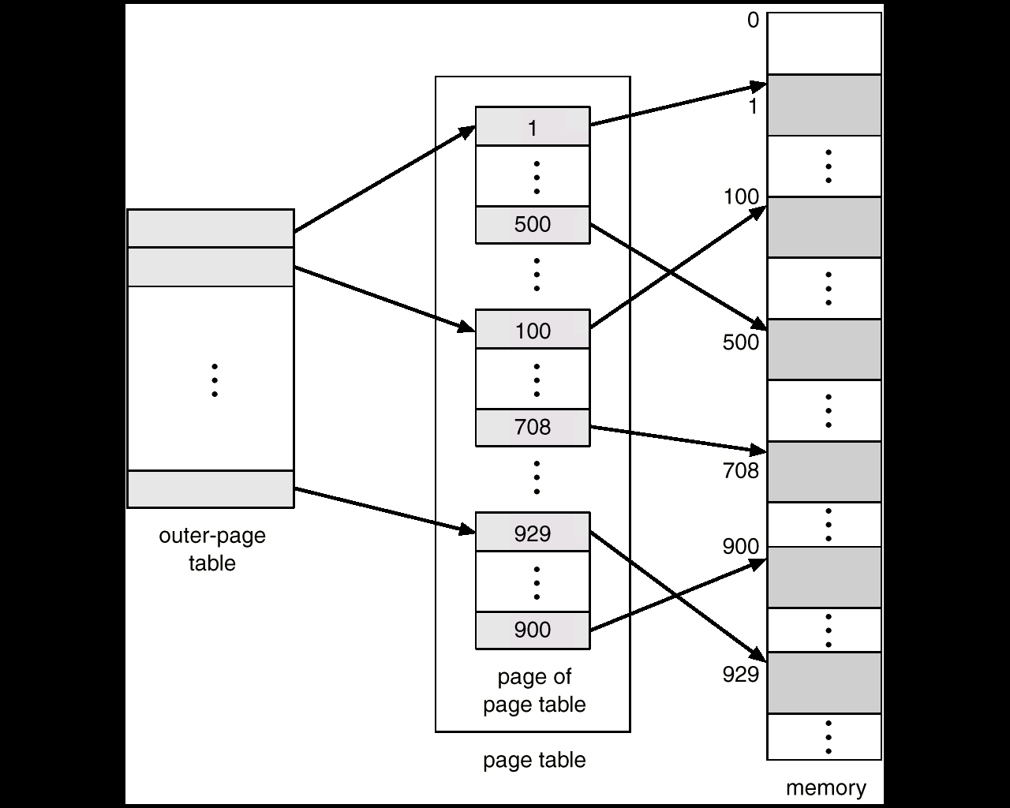
Fig.8.12. Two-level page-table scheme
The page table occupies (1+2¹⁰) chunks, (1+2¹⁰) *2¹⁰*4 =(4K + 4M) Bytes
2¹⁰=1K entries
chunk1
chunk0
2¹⁰=1K entries
chunk2¹⁰
2²⁰=1M entries,
2¹⁰*4 bytes in size
2²⁰*4K
=4 GB
注：内外页表采用相同大小的chunk

Slide 23
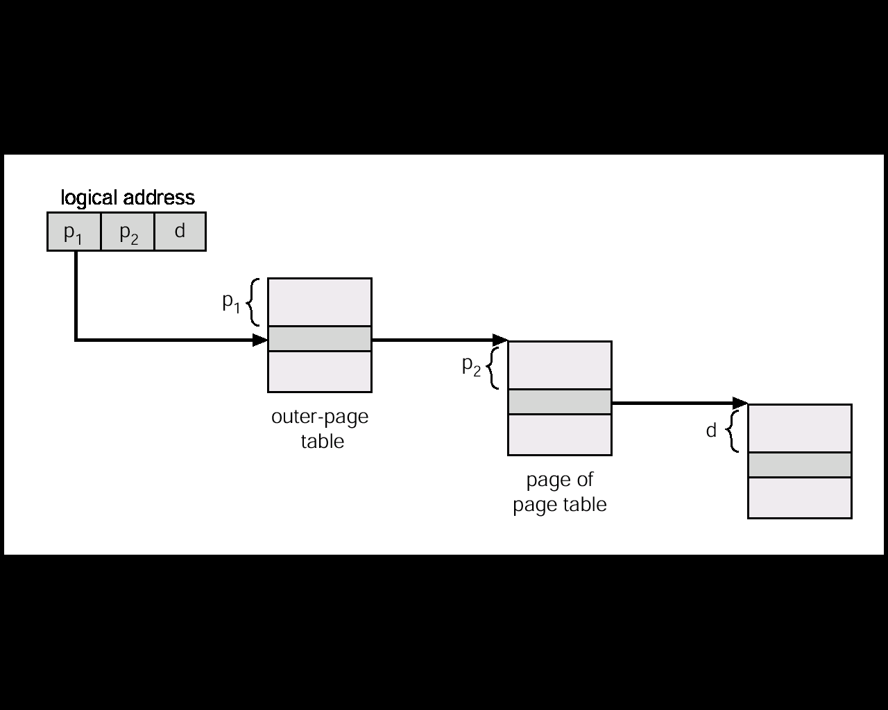
Fig.8.13 Address-translation scheme for a two-level 32-bit paging architecture

Slide 24
虚拟地址
目录位移
页表位移
页位移
页目录(每进程一个)
页表
内存块
块号
+
页表地址
+
代码或数据
.
.
.
.
.
.
.
.
.
二级页表结构及地址映射
页目录地址

Slide 25
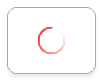
例11
某计算机采用two-level paging的分页管理机制，按字节编址，页大小为2¹⁰bytes，页表项大小为2字节，逻辑地址结构为
逻辑地址空间大小为2¹⁶pages
问：表示整个逻辑地址空间的页目录表中包含表项个数至少是：B
A. 64 B. 128 C. 256 D. 512
页目编号/outer page | 页号/inner page | 页内偏移/offset

Slide 26
例11
页大小为2¹⁰bytes，页表项大小为2字节，
逻辑地址空间大小为2¹⁶pages，共2¹⁰*2¹⁶bytes=2²⁶bytes, 逻辑地址26bits
假设：内页表中多个chunk、外页表的1个chunk均采用1个page大小（2¹⁰bytes ）的内存块来存储页表项，而1个页表项占2个字节，故
一个chunk中可以存储2¹⁰/2=512=2⁹个页表项，所以逻辑地址中内页号所占的地址位数为9位。由此推出，外页所占位数为7位，外页有128个表项；
共有2¹⁶个pages，一个内页表chunk可以存储512个page的物理地址/frame首地址高位，需要2¹⁶ /512= 2⁷ =128个内页表chunk，故外页表中应有128个表项指向内页中的每个chunk。
页目编号/outer page | 页号/inner page | 页内偏移/offset
25
18
10 9
0

Slide 27
例12 内存扩展-CPU利用率-吞吐量
1个多道程序设计系统采用实存管理技术并发执行多个大小均为300K的程序。假设各个进程在执行过程中有80%的I/O等待时间（即进程等待I/O的时间占其生命周期时长的80%）
(1) 当系统内存为900K时，有多大比例的cpu时间被浪费掉了？cpu利用率是多少？为什么?
(2) 若再增加300K内存，cpu利用率可提高多少？
(3) 假设系统内每个进程在其生命周期内处于running态执行程序指令的总时间均相同。当系统内存由900K增至1200K时，系统吞吐量可提高多少

Slide 28
例12 内存扩展-CPU利用率-吞吐量
(1) 当系统内存为900K时, 系统可容纳3个进程同时并发执行
根据题意，进程在执行过程中有80%的I/O等待时间, 表明进程等待I/O的时间占其生命周期时长的80%, 进程处于waiting状态的概率为0.8
对系统内并发执行的n个进程, 当这n个进程同时处于I/O等待时, cpu是空闲的
系统内3个并发进程同时处于I/O等待态而导致CPU空闲的概率为(80%)³=0.512
因此，系统有51.2%的CPU时间被浪费掉了，系统CPU的利用率为(1—51.2%)＝48.8%。

Slide 29
P1
CPU burst
20%
I/O burst
80%
P2
CPU burst
20%
I/O burst
80%
P3
CPU burst
20%
I/O burst
80%
P1, P2, P3 blocked
CPU空闲
51.2%

Slide 30
例12 内存扩展-CPU利用率-吞吐量
(2) 若再增加300K内存，系统可容纳４个进程同时并发执行
此时，CPU的利用率为 (1— (80%)⁴) = (1— 0.4096) = 0.5904
所以，若再增加300K内存，cpu利用率可提高：
(0.5904—0.488) / 0.488 = 20.98%

Slide 31
例12 内存扩展-CPU利用率-吞吐量
(3)根据题意，设系统内每个进程在其生命周期内处于running态执行程序指令(CPU burst)的总时间均为T
当系统内存为900K时, 系统可容纳3个进程并发执行。如果3个进程全部并发执行完所需时间为L₃，则：
CPU的利用率=3T / L₃=48.8%,
L₃ = 3T / (48.8%),
, 系统吞吐量Th₃=3/ L₃= (48.8%) / T

Slide 32
例12 内存扩展-CPU利用率-吞吐量
当系统内存由900K增至1200K时，系统可容纳４个进程同时并发执行。设4个进程全部并发执行完所需时间为L₄，则:
CPU的利用率 = 4T / L₄=59.04%,
L₄=4T / (59.04%),
系统吞吐量Th₄=4/ L₄= (59.04%) / T
因此，若再增加300K内存，系统吞吐量可提高：
［(59.04%) / T —(48.8%) / T］/ [(48.8%) / T]
= (0.5904—0.488) / 0.488 = 20.98%
= 20.98%
CPU利用率提高→系统吞吐量提高

Slide 33
补充作业
On a simple paging system with a page table containing 1024 entries of 13 bits (including one valid/invalid bit) each, and a page size of 4096 bytes
（a) what is the size of the logical address space?
(b) how many bits are there in a logical address?
(c) how many bits in the physical address specify the frame number?
(d) how many bits in the physical address specify the offset within the frame?
(e ) what is the size of the physical address space ？
(f) how many bits are there in a physical address?
要求：参照例4，画图

